Slide 1
ASM NGS Pre Conference NCBI Workshop Background Information - Part 4: Pathogen Detection
Hosted by NCBI Pathogen Detection Team

Slide 2
4. NCBI Pathogen Detection
Enables U.S. public health scientists to quickly identify foodborne pathogens and antimicrobial resistance, accelerating the response time to outbreaks and food recalls.

Slide 3
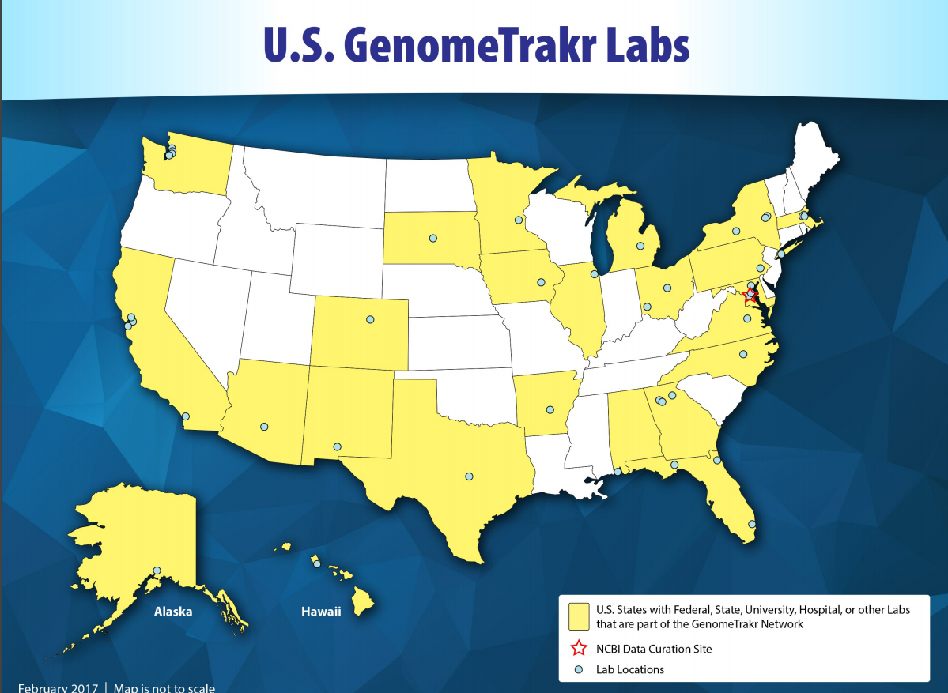
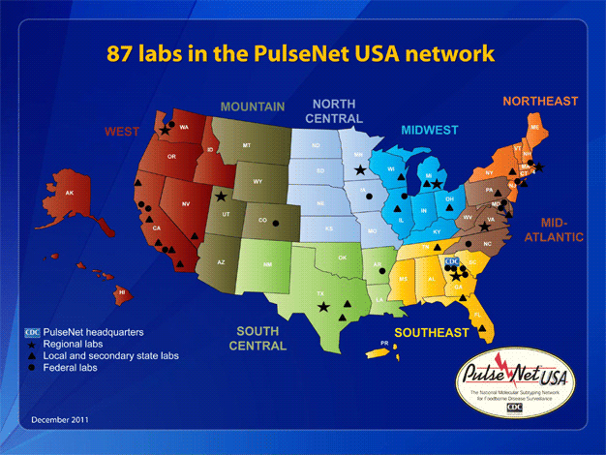
Started in 2013
FDA/CDC Initiated Real-Time Listeria* Project
as pilot to move beyond Pulsed Field Gel
Electrophoresis (PFGE) to Whole Genome Sequencing
FDA & CDC could leverage existing systems & work flows in the laboratory
Could NCBI play a role?
* Listeria chosen due to high morbidity
and mortality and low incidence in the
population (highest impact with least cost)

Slide 4
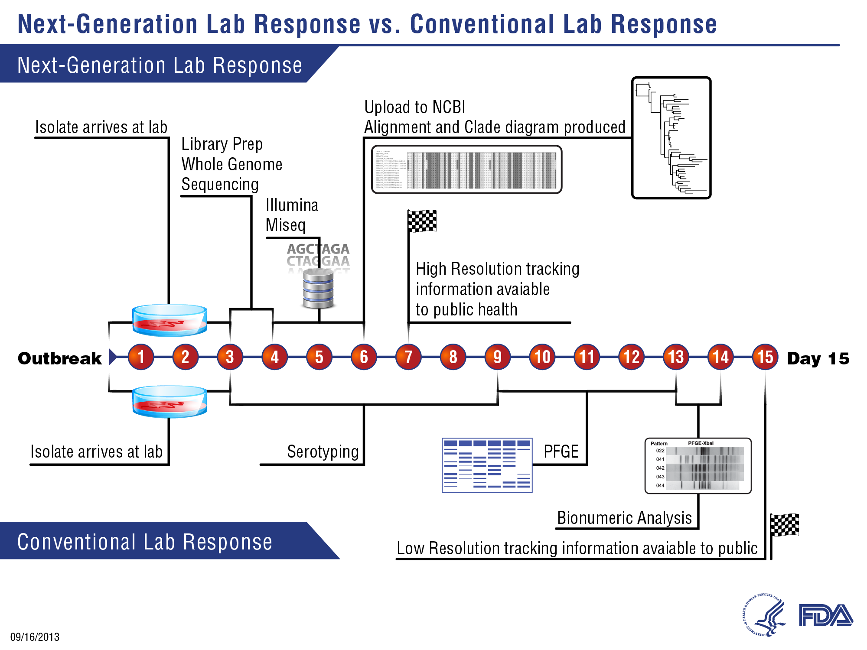
Comparison standard PFGE workflow vs. WGS workflow

Slide 5




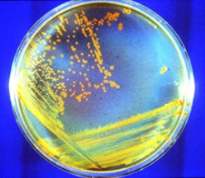

Real time surveillance of pathogens for outbreak detection and investigation
Salmonella enterica
Campylobacter spp.
L. monocytogenes
STECs
Sampling of clinical/human, food, animal, and environmental bacterial isolates
There are some international labs submitting
such as
Public Health England
GenomeTrakr
PulseNet
USDA
PHE
hospitals
Network includes federal and state public health labs,
and food safety labs, academic partners, ag, and vet labs
State agriculture & food regulatory labs
FSIS & FDA labs
food, environmental
State health labs (clinical)
Raw Genomic Sequence data
PulseNet National Database
CDC analysis (all raw sequence goes into NCBI
NCBI Submission Portal
Minimal metadata,
everything publically accessible,
sequence data in SRA
More extensive metadata, analyzed seq data (tools to translate) data shared among PulseNet labs only
Current status of distributed network

Slide 6
Data Reduction
Data
size
Data
usefulness
Raw data: hundreds of millions
of base pairs in short reads
Intermediate data: assembly of a
few million bases
Final Actionable Data:
cluster membership
phylogenetic tree
SNP distances
antimicrobial resistance gene
detection
Pathogen Detection turns big data into
meaningful data <24 hours

Slide 7
Analysis goals of current pipeline
Are these isolates clonally related?
What is the anti-microbial resistance, stress response, and virulence gene repertoire of this isolate
Analysis pipeline is completely automated, does not require human interaction
Both results presented in easy to use integrated web-interface

Slide 8
Pathogen Detection Pipeline (basics)
Lab
submission
SRA
Assembly
Annotation
Clustering/Neighbors
GenBank
AMRFinderPlus
Rapid reports (on FTP < 60 minutes after submission - select organisms and BioProjects only)
All 33 taxa
Clusters
Trees for each Clusters
AMR Genes per Isolate
(in web interface and FTP < 24 hours after submission)
Notes:
GenBank

Slide 9
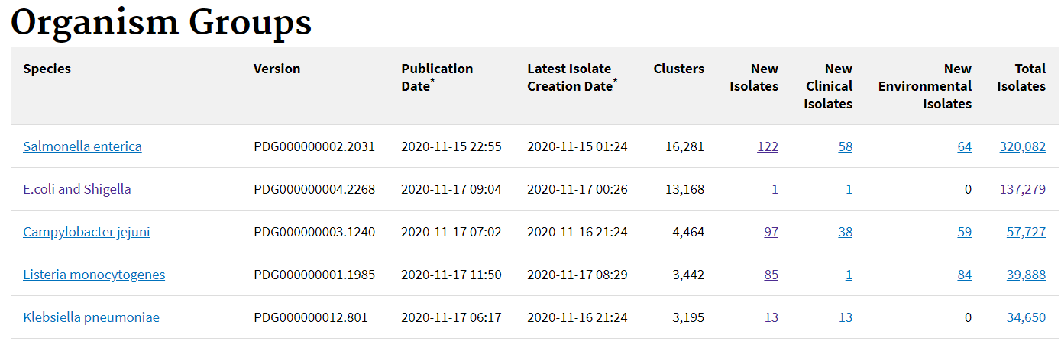
More than 30 different taxa including emerging fungal pathogen Candida auris
> 710,000 isolates in total
new isolates added since last publication
split between clinical
and environmental isolates
https://www.ncbi.nlm.nih.gov/pathogens/organisms/
*links go directly to search results in Isolates Browser

Slide 10
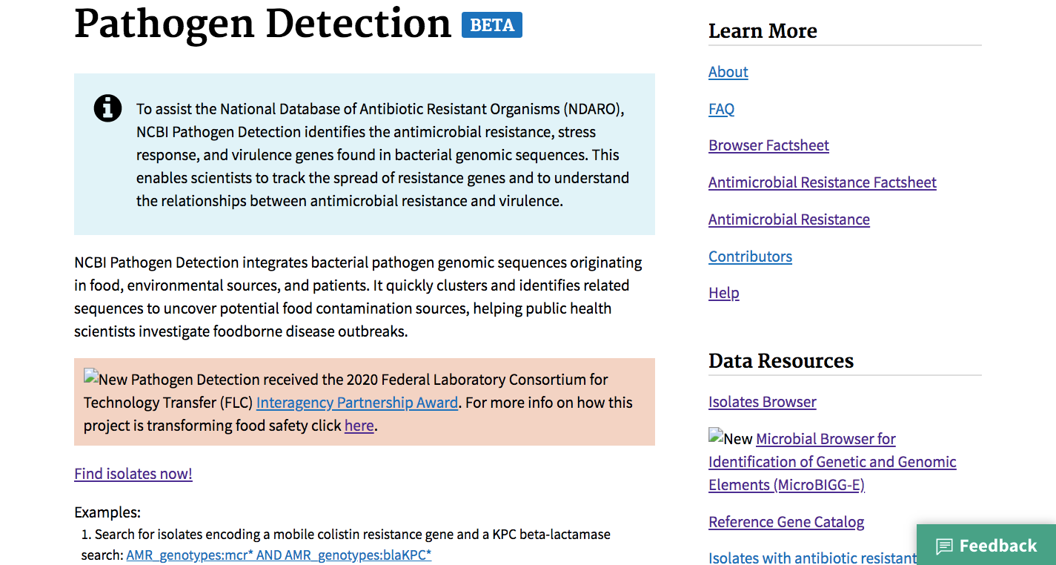
https://www.ncbi.nlm.nih.gov/pathogens/

Slide 11
NCBI Biosample – Pathogen Template for Metadata
FDA is working on a food source ontology with outside experts*
specificity makes the data more valuable–this is the minimal set
can add optional, free-text fields of your choosing
sample_name
organism
strain/isolate
subspecies
serovar
Category (attribute_package)
1a) Clinical/Host-associated
1a1) specific_host
1a2) isolation_source
1a3) host-disease
OR
1b) Environmental/Food/Other
1b1) isolation_source
1b2) food ontology*
1b3) IFSAC category*
collection_date
Geographic location
6a) geo_loc_name
OR
6b) lat_lon
collected by
What
When
Where
Who
the minimal metadata pathogen template, used to define what
critical items would be needed to identify sources of contamination
from food or environment that would be causing clinical cases
https://www.ncbi.nlm.nih.gov/pathogens/submit-data/

Slide 12
NCBI Biosample – Pathogen Template for Metadata
the two categories are shortened as epi-type in the Isolates Browser
these are used to compute min-same and min-diff SNP distance values
(shortest distance between to isolates)
min-same
clinical to clinical
OR
food/environmental to food/environmental
min-diff
clinical to food/environmental
the shorter this distance is, the greater likelihood the food/environmental
isolate is contributing to clinical cases*
* (all dependent on a full epidemiological and traceback analysis by experts)
sample_name
organism
strain/isolate
subspecies
serovar
Category (attribute_package)
1a) Clinical/Host-associated
1a1) specific_host
1a2) isolation_source
1a3) host-disease
OR
1b) Environmental/Food/Other
1b1) isolation_source
1b2) food ontology*
1b3) IFSAC category*
What
https://www.ncbi.nlm.nih.gov/pathogens/submit-data/

Slide 13
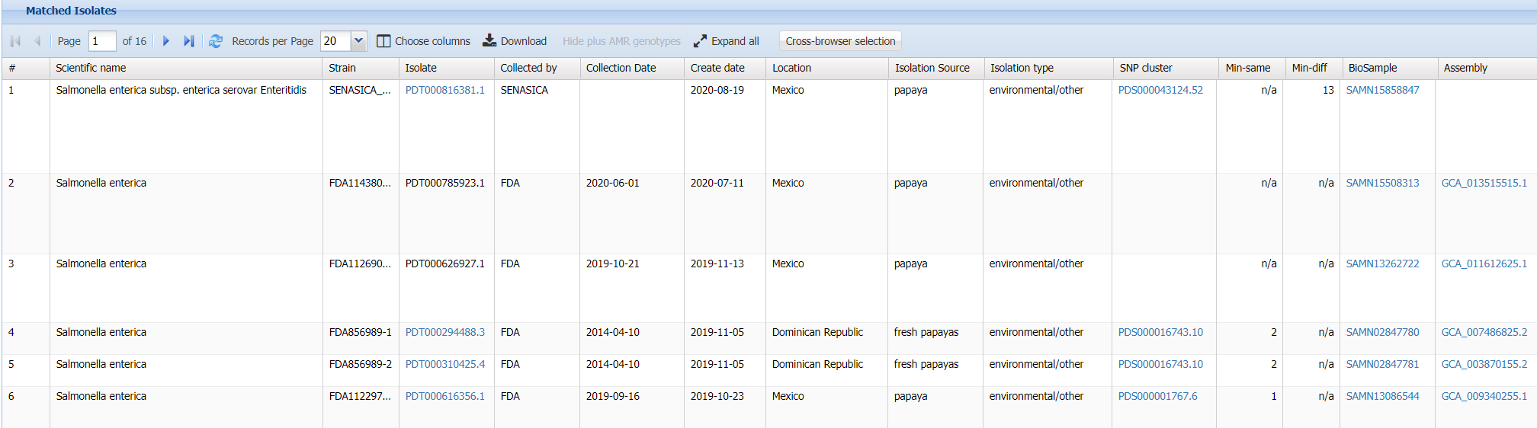
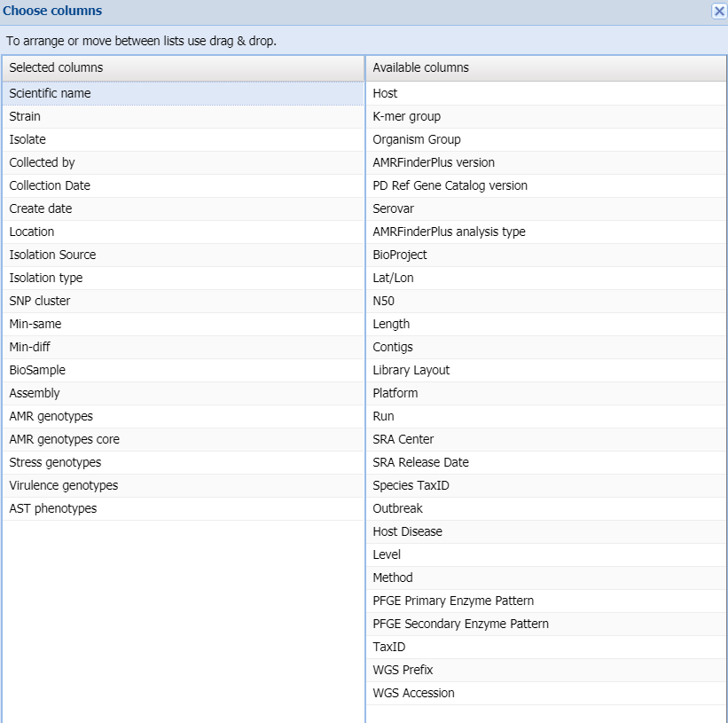
this food isolate from Mexico is 13 SNPs away from a clinical case
metadata per isolate is composed of both submitted metadata
and computed data generated by the Pathogen
Detection pipeline
this food isolate from the Domincan Republic is 2 SNPs away from another food or environmental isolate, but is not near to any clinical case

Slide 14
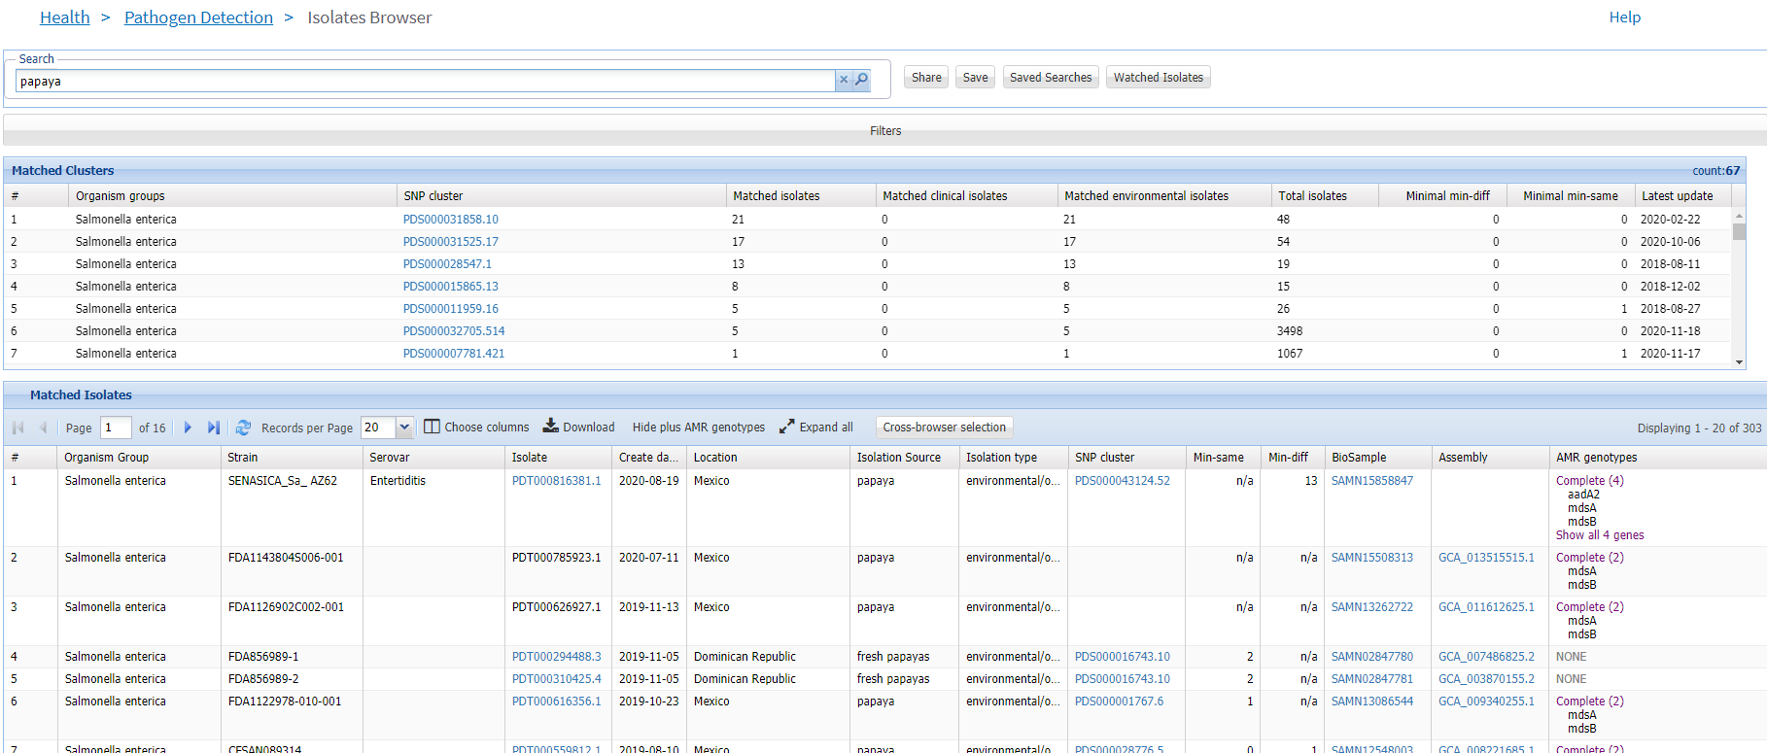
Isolates Browser
A
B
C
A
search box
B
matched clusters table (every row is a cluster)
C
matched isolates table (every row is an isolate)
https://go.usa.gov/xmHMu

Slide 15
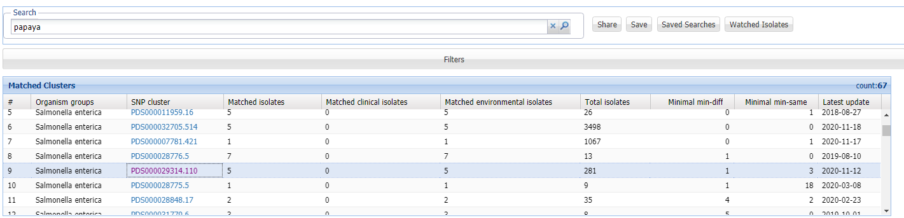
Pathogen Detection Portal - Papaya Outbreak
Isolate Browser allows users to quickly identify potential outbreaks
5 isolates from this one
cluster match the search
term "papaya"
they are all food/environmental
isolates in a cluster of 281 total
isolates
at least one of these isolates is 1 SNP
away from a clinical isolate
click on the cluster accession (PDS#) to open the next view
https://go.usa.gov/xmHMu

Slide 16
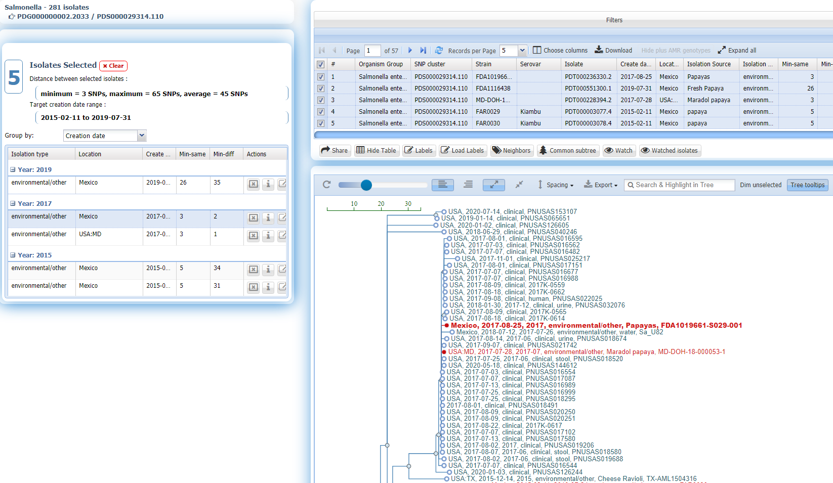
B
A
C
A
navigation panel
B
isolate table
C
SNP tree (phylo tree)
of the 5 isolates, two have
very small distances to a clinical case
clicking on the isolate from Mexico
will shift the tree view to that isolate
the two papaya isolates are both
contained within a clade of clinical cases
and all within very short SNP distances
Clicking on the cluster from previous slide
opens the SNP Tree Viewer

Slide 17
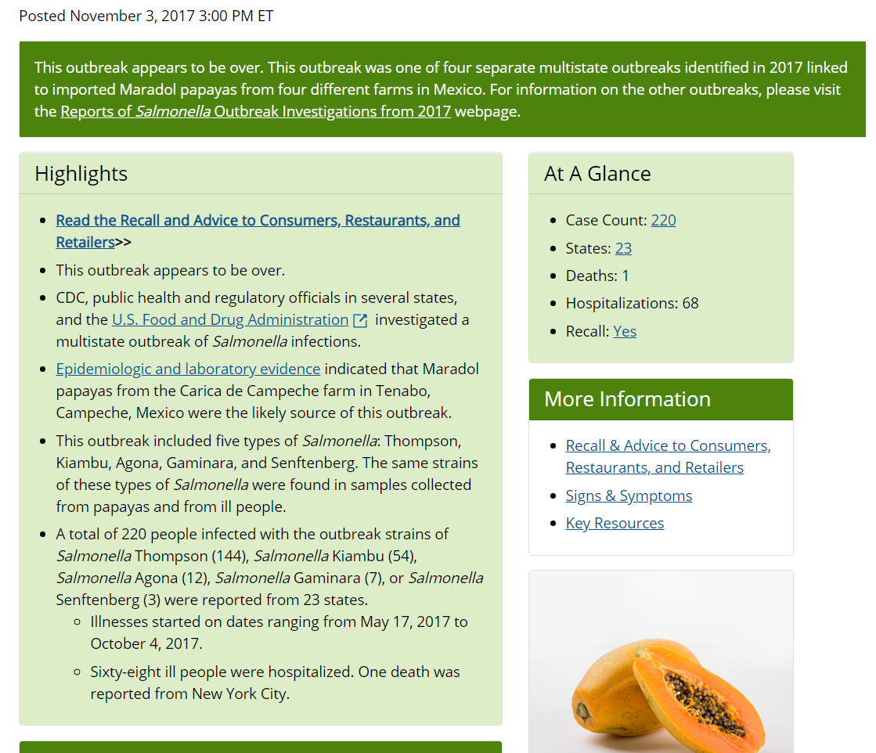
Papaya Outbreak
this outbreak was multinational, multistate,
and polyclonal
it included five different serovars of Salmonella
the cluster and phylogenetic tree on previous
slides was only one part of the overall outbreak
using the Isolates Browser, it only took two mouseclicks
to arrive at the conclusion that the papaya isolates
were likely contributing to a number of clinical casess
https://www.cdc.gov/salmonella/kiambu-07-17/index.html

Slide 18
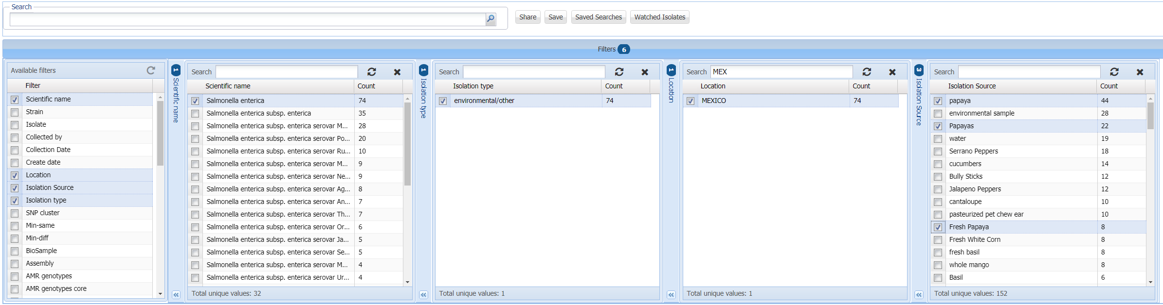
New Isolates Browser Filter Options
Filters selected from the set of data fields/
columns in the browser
Multiple fields can be filtered
Selections in one filter update counts in the other filters
Multiple selections can be made in the filters
Closing the filter button generates the search terms (useful to set up saved searches)

Slide 19
Automated Alerts: Email Notifications
Since all organism groups can be updated independently, keeping on top of the latest updates
can be problematic.
Automatic notifications can be set up once a user has obtained a MyNCBI account and logged in.
Two types of notifications can be set up.
Saved searches: user enters a search term, then saves the search - all new isolates that match the
search term will be sent via email to the email address tied to the MyNCBI account.
Watch notifications: user flags a particular isolate that is in a cluster within the SNP Tree Viewer. User
can set a SNP distance for the notification. Any new isolates that join the same cluster within
that SNP distance are sent via email to the email address tied to the MyNCBI account.
Email notifications include links directly to the Isolates Browser and SNP Tree Viewer.

Slide 20
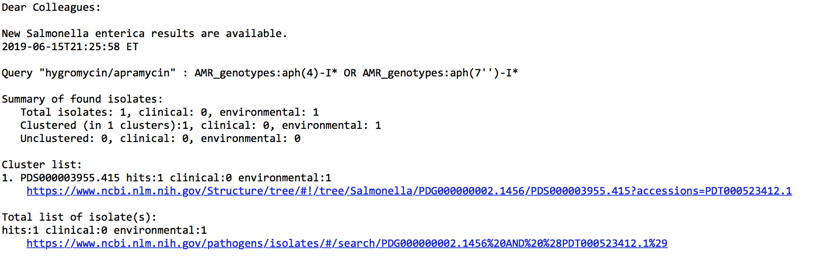
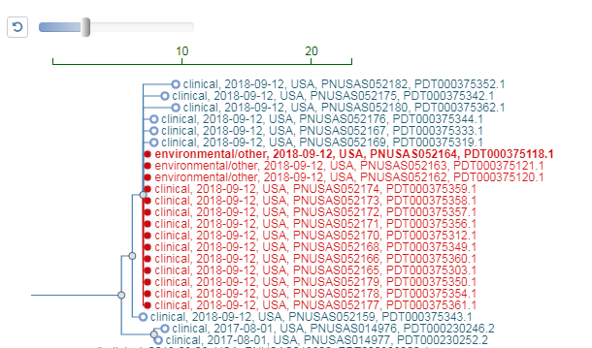
Example of an Automated Alerts: Email Notifications
Requires MyNCBI login
- email includes links highlighting new isolates
within SNP trees when opened in browser
https://go.usa.gov/xmHFU

Slide 21
AMR Informatics AMRFinderPlus Uses a Curated Database, HMMs, and BLAST to Identify AMR genes and point mutations plus…
Proteins
Nucleotide
Report on
resistance genes
- integrated into Pathogen Detection Isolate Browser for >710,000 pathogen isolates
Available at:
https://github.com/ncbi/amr/wiki
HMMs and
BLAST
AMR
database
”Plus” contains:
virulence factors for select organisms
acid, biocide, metal, and heat resistant genes
>6,000 resistance proteins
> 600 HMMs
44 drug classes resisted
~60% beta-lactamases
AMRFinderPlus now finds point mutations for ten taxa (currently)
AMRFinderplus is continuously being developed, new genes
and point mutations are added after curation by NCBI personnel

Slide 22
AMR Informatics - User Interfaces
Reference Gene Catalog
Every row is a reference gene or point mutation
Pathogen Detection Isolate Browser
Every row is an assembled isolate, possibly with AMR, virulence, and/or stress response genes and AST data (if present)
https://www.ncbi.nlm.nih.gov/pathogens/isolates/
100,000 X N
1,000 X N
https://www.ncbi.nlm.nih.gov/pathogens/refgene/
Download genomes
Every row is an AMR-specific HMM
MicroBIGG-E (Microbial Browser for Identification of Genetic and Genomic Elements)
Every row is an AMR, virulence, and/or stress response genes with method, type, subtype, class, subclass, and supporting evidence
HMM AMR Browser
100 X N
1, 000,000 X N
Download genes, genes + flanks, contigs
https://www.ncbi.nlm.nih.gov/pathogens/microbigge/

Slide 23
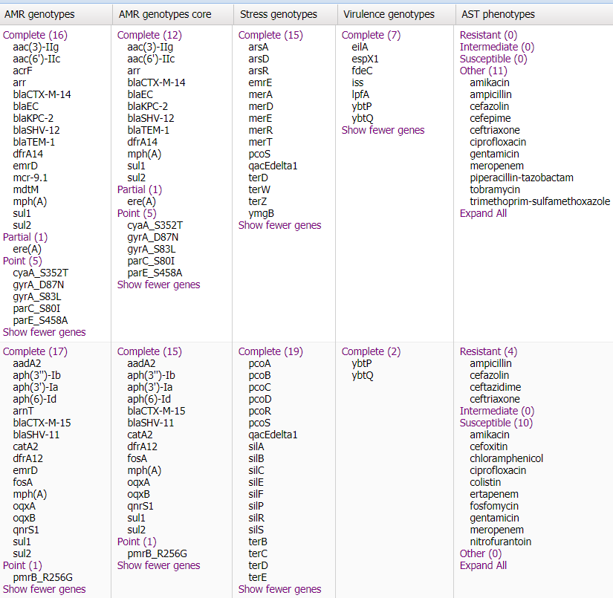
The Isolates Browser contains identified
genes for antimicrobial resistance,
virulence, and stress response using
AMRFinderPlus. Genes are broken down
by method from that tool (complete,
partial, point, HMM, etc.)
Susceptibility data, if available, is
provided by submitters. Susceptibility
calls are broken down based on
S/I/R/ND made by the submitter.
Full AST data including MICs (if available)
are available in BioSample database.

Slide 24
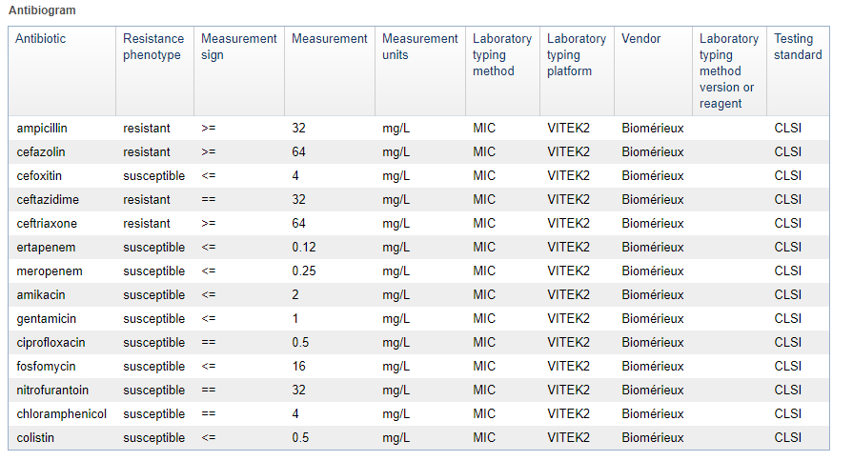
Full AST data (if submitted) is available in BioSample as an embedded table as an antibiogram
samples with AST data can be found with the search: antibiogram[filter]

Slide 25


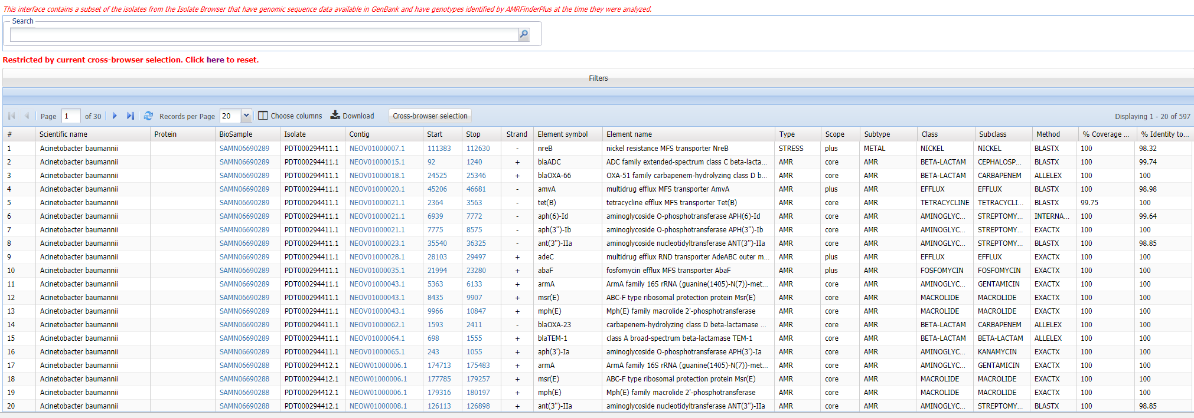
MicroBIGG-E: Cross-browser selection
selections in the Isolates Browser can be used to select data in the MicroBIGG-E
data in the MicroBIGG-E is restricted both by the availibilty of
the assembly in GenBank and in this case by the selection of
isolates in the Isolate Browser for the cross browser selection
every row in the MicroBIGG-E is a element (gene, point mutation) identified by
AMRFinderPlus - and restricted by those genomes available in GenBank

Slide 26
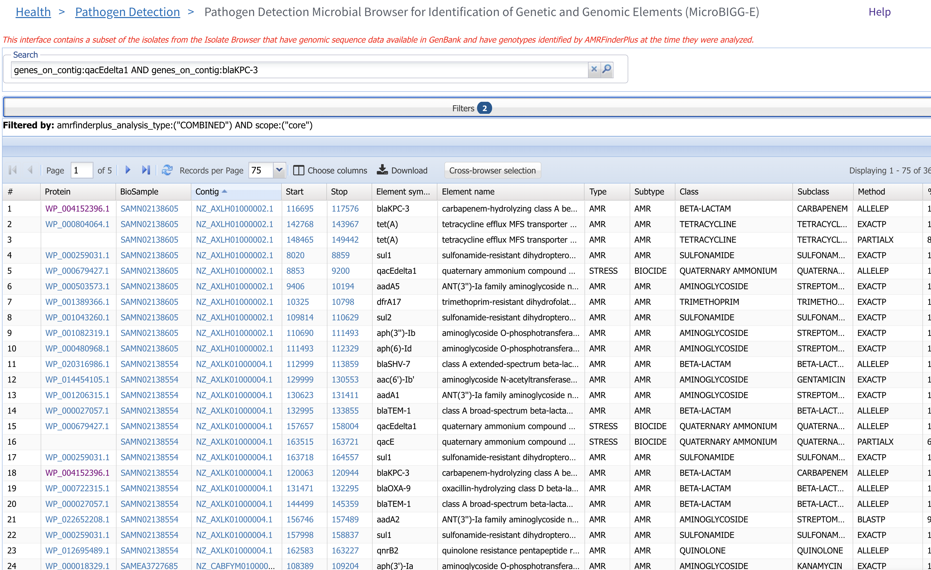
MicroBIGG-E: Finding Genes on the Same Contig
the MicroBIGG-E can
also be searched directly
in this case the search is
for two genes on
the same contig AND
filtered by analysis type
and scope
the two genes are
on the same contig
two different contigs
are shown by the
colored boxes

Slide 27
The Pathogen Detection resources facilitate the following:
Are these isolates clonally related?
- by providing an easy-to-use web interace to quickly assess genetic similarity
- by building a rapid analysis pipeline that presents the results:
< 60 minutes after submission (Rapid Reports)
< 24 hours after submission (web interface)
- by building an automated notification system so users can stay abreast
of the latest data without having to constantly check the web page
- by releasing data on FTP for those building automated systems for data retrieval

Slide 28
The Pathogen Detection resources facilitate the following:
What is the anti-microbial resistance, stress response, and virulence gene repertoire of this isolate
- by building an up-to-date reference catalog AMR, stress response, and virulence genes in
collaboration with external experts
- by building a tool, AMRFinderPlus, that can identify genes, proteins, and point mutations in
a pathogen assembly using the reference catalog
- by running the AMRFinderPlus tool on all bacterial pathogen assemblies in the Isolates Browser
and providing the gene calls for each isolate
- by providing details on the identified gene for the subset of pathogen assemblies that are in
GenBank including contig position and strength of evidence for the call
- by providing a format for submitters to delivery antibiotic susceptibility data and to integrate
that into the Isolates Browser

Slide 29
For more information:
Check the detailed help documentation:
https://www.ncbi.nlm.nih.gov/pathogens/pathogens_help/
Write to us at:
pd-help@ncbi.nlm.nih.gov

Slide 30
Acknowledgements
Richa Agarwala
Victor Ananiev
Azat Badretdin
Slava Brover
Joshua Cherry
Jinna Choi
Vyacheslav Chetvernin
Pavan Chilamakuri
Robert Cohen
Michael DiCuccio
Boris Fedorov
Mike Feldgarden
Lewis Geer
Renata Geer
Dan Haft
Lianyi Han
Avi Kimchi
Michel Kimelman
William Klimke
Alex Kotliarov
Valerii Lashmanov
Aleksandr Morgulis
Eyal Moses
Chris O'Sullivan
Arjun Prasad
Edward Rice
Kirill Rotmistrovskyy
Alejandro A. Schaffer
Nadya Serova
Stephen Sherry
Sergey Shiryev
Martin Shumway
Oleg Shutov
Douglas Slotta
Alexandre Souvorov
Tatiana Tatusova
Francoise Thibaud-Nissen
Igor Tolstoy Lukas Wagner
Hlavina Wratko
Chunlin Xiao
Alexander Zasypkin
Eugene Yaschenko Mingzhang Yang
David Lipman
James Ostell
Kim Pruitt
CDC
FDA/CFSAN
GenFS
USDA-FSIS
PHE/FERA
NHGRI
NIAID
WRAIR
Broad
Wadsworth/MDH
Vendors: PacBio, Illumina, Roche
pd-help@ncbi.nlm.nih.gov
This research was supported by the Intramural Research Program of the NIH, National Library of Medicine. http://www.ncbi.nlm.nih.gov
National Center for Biotechnology Information – National Library of Medicine – Bethesda MD 20892 USA

